Slide 1
Nanoscale Kinetic Segregation at the Early Immune Synapse
T-cell, speed, sensitivity, signal/noise
T-cell & Antigen Presenting Cell (APC)
Sizes
What can we see?
Super-resolution microscopy
Monte-Carlo simulations
PGM

Slide 2
Sequence
of raw
Images
Super resolution microscopy (how it works?)
Sequence
of localized images
Photo Activated Localization Microscopy (PALM)
Accumulated raw image
CCD display
+
+
+ ... =
Resolution limit
~200 nm
Localization procedure
Accumulated localized image
+
+
+ ... =
~20 nm
Localized data point

Slide 3
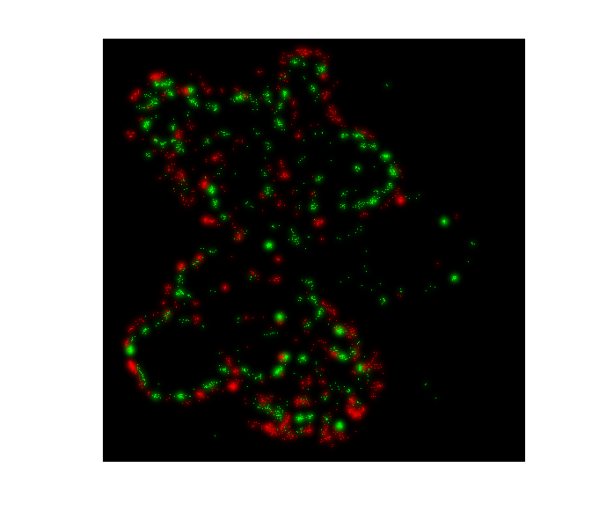
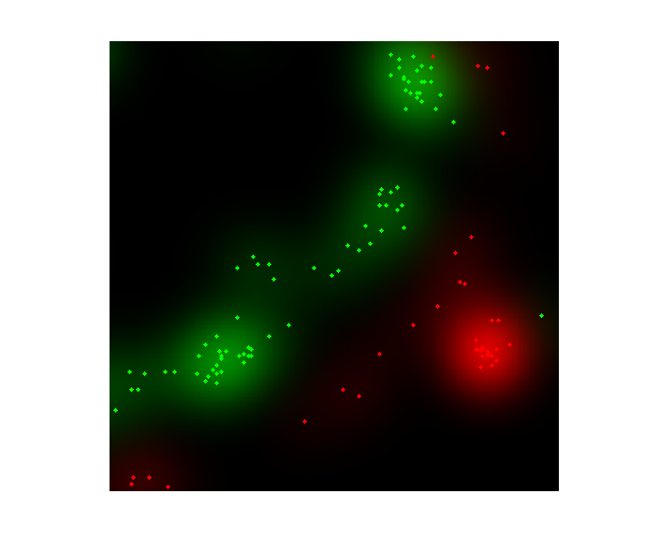
Super resolution microscopy (resolution limit vs. super-resolution)
TCR
TCR
CD45
CD45
2μm
200nm
The ‘clouds’ are at resolution limit, the dots are at super-resolution.

Slide 4
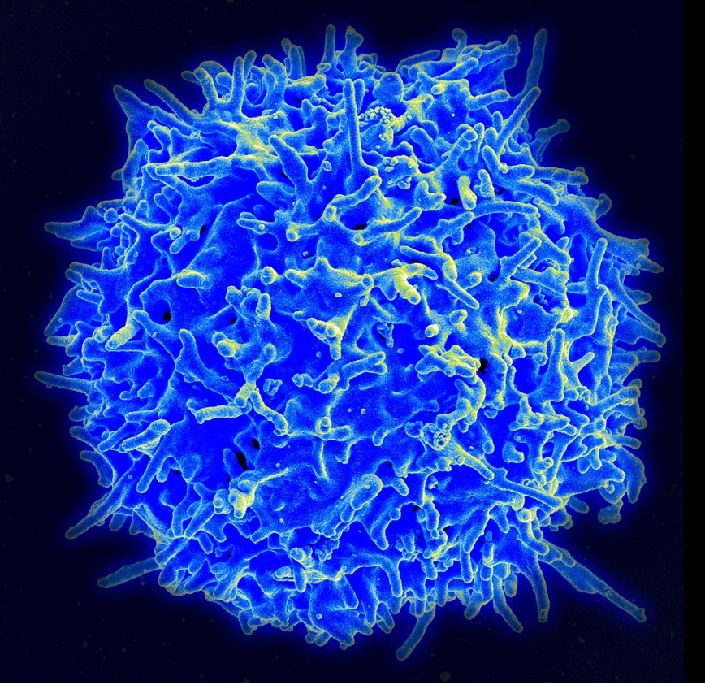
T-cell
Scanning Electron Microscopy (SEM) image of a T-cell
Cell size ~10 microns
By NIAID/NIH - NIAID Flickr's photostream, Public Domain, https://commons.wikimedia.org/w/index.php?curid=18233598

Slide 5
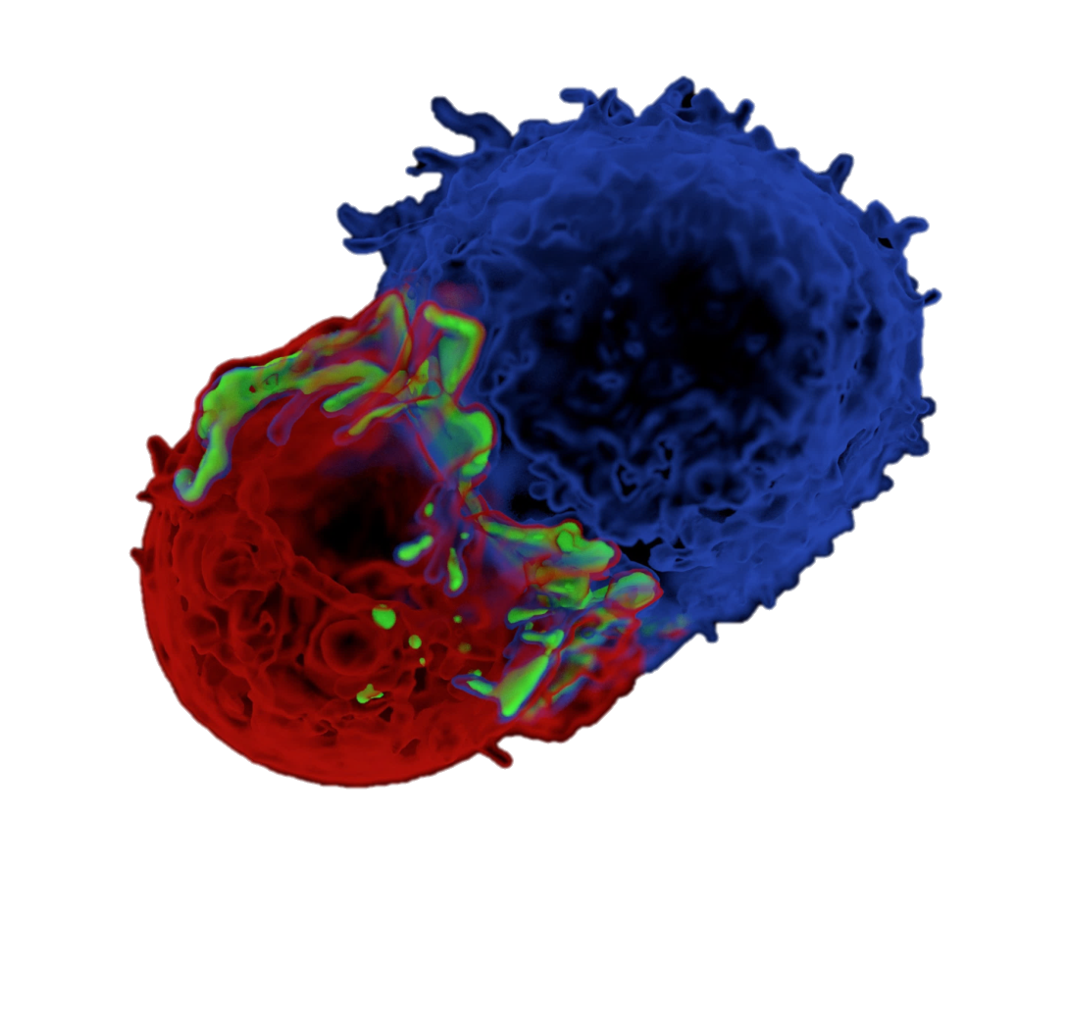
Kinetic segregation model for T-cell activation
T-cell
(No contact)
TCR
LFA-1
CD45
T-cell
pMHC
ICAM
APC
APC
(contact)
T-cell
James et. al. Nature 2012
APC

Slide 6
Monte-Carlo (Metropolis) simulations
Interaction energies
Acceptance probability
H_{i,j} = H_{ij,membrane} + V_{ij,rec-lig}+ V_{ij,spring}
1, ΔE < 0
Membrane elastic energy
Binding interaction
repulsive interaction
P_{accept} =
e^{-ΔE}, ΔE > 0
Membrane cross section
Interaction potentials
T-cell
Z(nm)
50
Attraction
Repulsion
40
30
Repulsion
20
V_{CD45}
TCR-pMHC
Fixed z
10
APC
-10
0
10
20
30
40
V(K_{B}T)
Notes:
The simulation grid size is 10nm. The locations of the molecules can be taken from the experimental data and produce more realistic results. The interaction potentials govern the dynamics of the Monte-Carlo simulation. The energy is calculated for every grid coordinate (i,j).

Slide 7
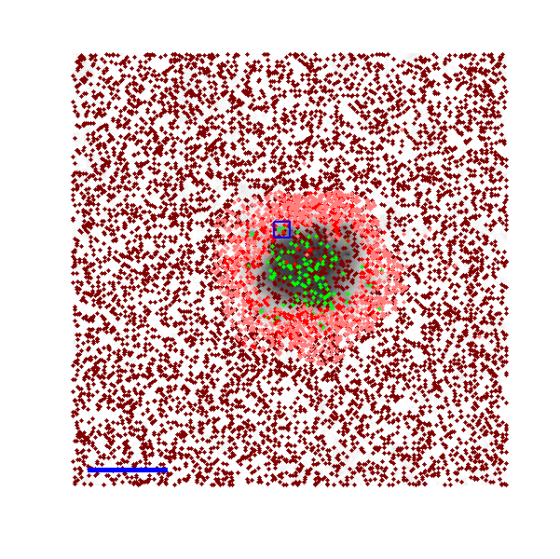
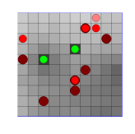
Simulation 3D view
Top view
1μm
3D view
100nm
50nm
0nm

Slide 8
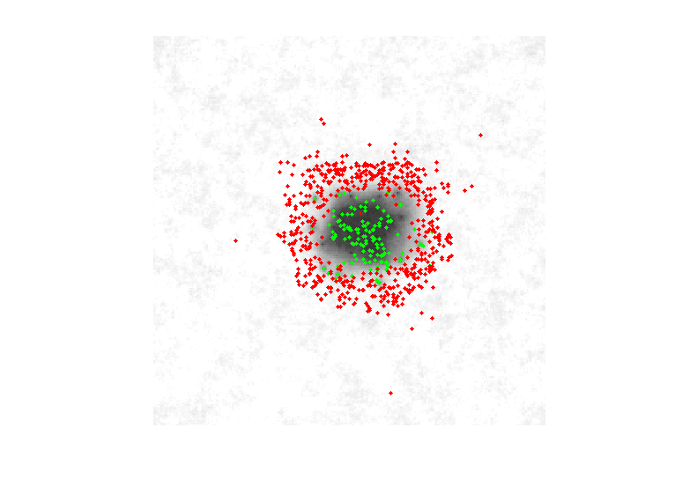
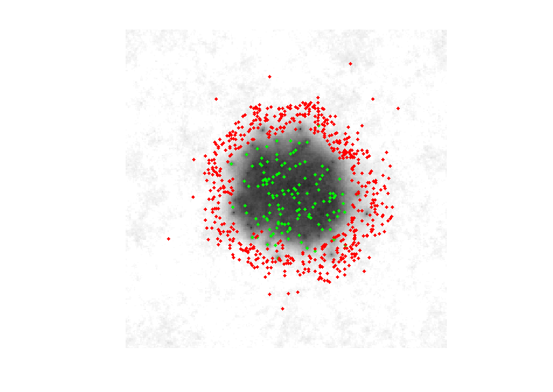

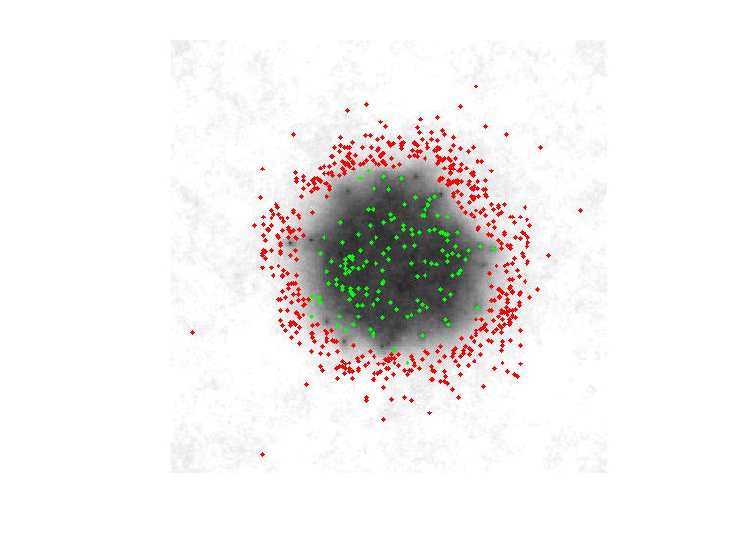

Slide 9
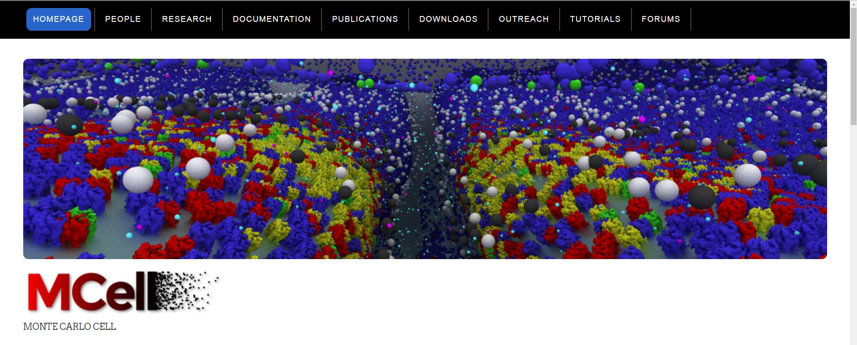
Full 3D
Whole cell
All surface molecules (100M)

